Slide 1
Introduction to Hadoop
Pravin Y Pawar

Slide 2
Every …
Day
NYSE generates 1.5 billion trade data
Facebook stores 2.7 billion comments and likes
Google processes 24 petabytes of data
Minute
Facebook users shares 2.5 million pieces of content
Twitter users tweet nearly 300000 times
Instagram users posts 220000 photos
Second
Banking applications process 10000 credit card transitions

Slide 3
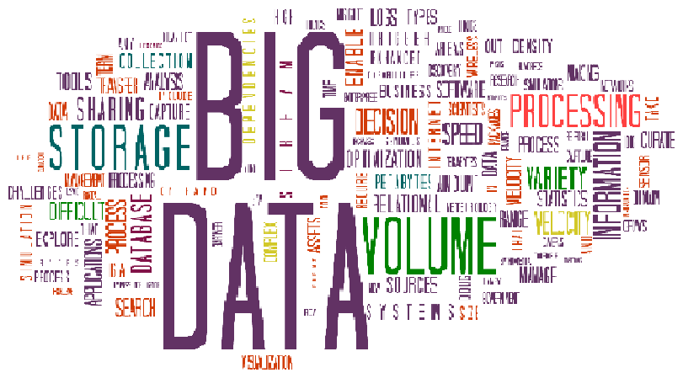
Big Data Challenges
Volume, Variety and Velocity
“How to store terabytes of mounting data?”
VOLUME
“How to handle structured, semi-structured and unstructured data?”
VARIETY
“How to manage the data that is getting generated at very fast speed?”
VELOCITY
Image Source : amcham

Slide 4
Why Hadoop?
Key consideration
Hadoop can handle
Massive amount of data
Different kinds of data
In fast manner
Advantages
Low cost – open source
Computing power – many nodes can be used for computation
Scalability – simple add nodes in system
Storage Flexibility – can store unstructured data easily
Inherent data protection – protects against hardware failures

Slide 5
Distributed Computing Challenges
Problems and Solutions
Storage of huge amount of data
More systems , more failures
How to retrieve the data stored on the failed node?
Hadoop solves this by Replication Factor (RF)
Number of data copies of a given data item / data block stored across the network
Processing the huge amount of data
Data is spread across systems, how to process it in quick manner?
Challenge is to integrate data from different machines before processing
Hadoop solves this by MapReduce Programming
Programming model to process huge amount of data at same time in quick manner

Slide 6
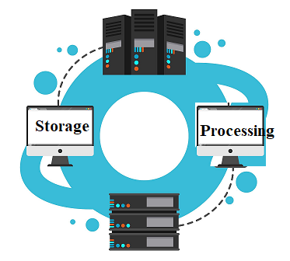
What is Hadoop?
Key Aspects
Two Tasks
Massive Data Storage
Huge of amount of data across several nodes
Uses low cost commodity storage
Faster Data Processing
Has everything needed for data processing application development
Computation done parallel on several nodes at same time

Slide 7
Key Aspects
Open Source
Free to download, use and contribute to
Framework
Has everything needed for application development and execution
Distributed
Uses multiple computers for data storage and processing
Uses parallel processing across multiple nodes
Massive Storage
Stores huge amount of data across nodes of low-cost commodity hardware

Slide 8
Hadoop Core Components
HDFS
Storage component
Distributes data across multiple nodes
Natively redundant
MapReduce
Computational framework
Splits tasks across multiple nodes
Processes data in parallel
Core Components
MapReduce
HDFS

Slide 9
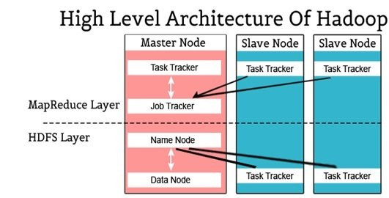
Hadoop High Level Architecture
Image Source : intellipaat

Slide 10
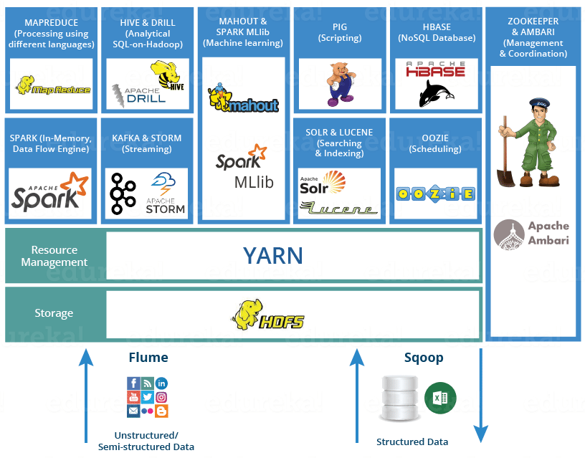
Hadoop Ecosystem
Image Source : Edureka

Slide 11
Thank You!
Reference :
Big Data and Analytics by Acharya, Chellappan
In our next session: Hadoop Architecture

